Slide 1


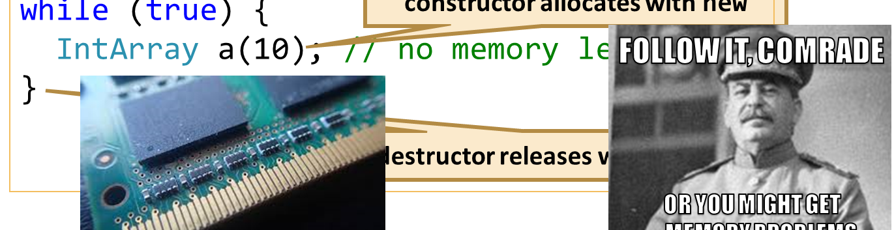
Destructors, Constructors, Copy-Assignment
Special/Default Class Members, Destructors, Rule of 3/5/0
Zhivko Petrov
A guy that knows C++

Slide 2

Table of Contents
Special, Default, Deleted Class Members
Resource Acquisition is Initialization (RAII)
Rule of Three
Rule of Zero

Slide 3
Questions
sli.do #cpp-softuni

Slide 4
Special Class Members
Destructors, Copy-Assignment/Construction

Slide 5
Special Class Members
Members called by C++ in special cases
Default Constructor – allocating objects & arrays
Destructor – when lifetime ends (e.g. due to scope or delete)
Copy-ctor – passing non-reference parameters/returning values
Copy-assignment – when operator= is used
Move ctor & assignment – for C++11 move semantics

Slide 6
Default Constructor Callers
Automatic local/global non-primitive objects
Arrays with default values
Fields missing from initializer list
Called in declaration order
Before owner’s constructor body
class Lecturer {
double rating; string name;
public: Lecturer(string name)
// rating() default ctor call
: name(name) {}
};
string s; // default ctor call
Lecturer steve; // default ctor call
Lecturer cpp[2]{ Lecturer("GG") }; // default ctor for cpp[1]

Slide 7
Auto-gen Default Constructor
Initializes each object field – calls default ctors in initializer list
Auto-generated if NO constructor declared explicitly
... and all fields have a default constructor
class Lecturer {
double rating;
string name;
public:
Lecturer()
: name() // set to ""
// NOTE: rating not set
{}
};
class Lecturer {
double rating;
string name;
};

Slide 8
Default Constructor
LIVE DEMO

Slide 9
Copy Construction/Assignment
ClassName(const ClassName& other)
Callers: return statements and non-reference parameters
ClassName& operator=(const ClassName& other)
Callers: assigning a value to an object with =
Copy-elision: compilers optimize to avoid copies
E.g. inlining functions & merging initialization and assignment
Can be disabled, e.g. -fno-elide-constructors in g++/gcc

Slide 10
Auto-gen Copy Constructor/Assignment
Copy-construct/assign each field with matching from parameter
Auto-generated if NO move constructor/assignment
… and each field supports copy-construction/assignment
Lecturer(const Lecturer& other)
: rating(other.rating), name(other.name) {}
...
Lecturer& operator=(const Lecturer& other) {
if (this != &other)
{this->rating = other.rating; this->name = other.name;}
return *this;
}
...

Slide 11
Copy Construction & Assignment
LIVE DEMO

Slide 12
Destructors
~ClassName() ... – called at object lifetime end
e.g. delete or automatic storage scope end
Common usage: free used resources
e.g. delete memory allocated by new
class IntArray {
int* data; int size;
public:
IntArray(int size)
: data(new int[size])
, size(size) {}
~IntArray() {
delete[] this->data;
}
constructor allocates with new
while (true) {
IntArray a(10); // no memory leak
}
destructor releases with delete

Slide 13
Auto-gen Destructor
"Destructs" each object field – i.e. calls each field’s destructor
Auto-generated if no destructor declared
NOTE: inheritance can change this behavior
class NamedArray {
int* data; int size;
string name;
public:
...
~NamedArray() {
// NOTE: no call for primitives
name.~basic_string();
}
}
class NamedArray {
int* data; int size;
string name;
}

Slide 14
Destructor
LIVE DEMO

Slide 15
Explicit Auto-gen and default
Getting default special members with NO auto-generation
E.g. class has constructor, no default constructor auto-generated
Hard way – write implementation matching auto-generated
Easy way (C++11) – use = default after member signature
Lecturer()
: name() {}
Lecturer(const Lecturer& other)
: rating(other.rating)
, name(other.name) {}
Lecturer()
= default
Lecturer(const Lecturer& other)
= default

Slide 16
Disabling Special Members with delete
Sometimes auto-generated methods need to be disabled
E.g. unique_ptr<T> disables copying
Hacky^{[1]} Hard way – declare the members as private
Easy way (C++11) – use = delete after member signature
[1] this only prevents outside access, which isn’t always enough
class Array {
...
private:
Array(const Array& other) { ... }
...
};`
class Array {
...
Array(const Array& other)
= delete;
...
};

Slide 17
Default and Deleted Members
LIVE DEMO

Slide 18
Quick Quiz
TIME:
struct Lecturer {
double rating; string name;
Lecturer(string name, double rating)
: name(name), rating(rating) {}
Lecturer(const Lecturer& other) {
*this = other;
}
Lecturer& operator=(Lecturer other) {
this->name = other.name;
this->rating = other.rating;
return *this;
}
};
What will this code do?
Print "Bill"
Print ""
Print an undefined string
Cause a runtime error
Lecturer a("Bill", 4.2);
Lecturer other(a);
cout << other.name <<endl;

Slide 19

C++ Pitfall: Doing a Copy in a Copy Constructor
The operator= used by the copy constructor here accepts a copy.
That’s an infinite indirect recursion – copy constructor calls itself to create the copy for the parameter of operator= it calls
Some compilers will refuse to compile this (e.g. Visual C++ 2017)

Slide 20
Resource Acquisition is Initialization
Associating Resources with Object Lifetime

Slide 21
RAII
RAII – resource usage is tied to object lifetime
Objects acquire their resources on initialization
Objects release their resources on destruction
Effect: no resource leaks if no object leaks
"Resources" – dynamic memory, streams, files, locks, etc.
Allocate in constructor, deallocate in destructor
Some cases might require allocation in methods
C++ guarantees destructor execution, even on error

Slide 22
RAII in the STL
All STL container classes are RAII
vector<T>, list<T>, map<K, V>, ...
C++ Streams are RAII
E.g. file streams open file on construction & close on destruction
shared_ptr<T> extends RAII to "multiple ownership"
Multiple objects own a resource
Release when lifetime of last remaining owner ends

Slide 23
Exercise 1: SmartArray
Implement a SmartArray<T> class that uses dynamic memory
Must be RAII, but STL containers/smart pointers NOT allowed
Has size, has index access (with operator[])
Can be resized
No support for copying or assignment
Bonus: even more RAII
Don’t use (directly) new in methods
Bonus: enable iteration (e.g. with range-based for loop)

Slide 24
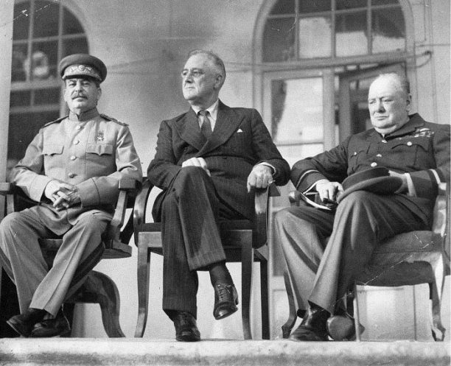
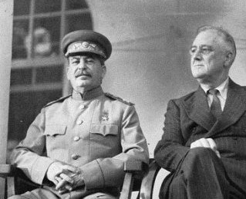
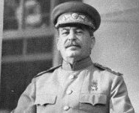
Rule of Three / The Big Three
FOLLOW IT, COMRADE
OR YOU MIGHT GET … MEMORY PROBLEMS
Why Constructor + Destructor isn’t Enough

Slide 25
Destructors and Copies
Constructor increases a static value, destructor decreases
void example() {
Lecturer a("Dandelion", 1),
b("Geralt", 1.3),
c("Yen", 4.2);
vector<Lecturer> lecturers;
lecturers.push_back(a);
lecturers.push_back(b);
lecturers.push_back(c);
}
class Lecturer {
static int Total;
...
public:
Lecturer(...) ... { Total++; }
~Lecturer() { Total--; }
...
};
int Lecturer::Total= 0;
example(); cout << Lecturer::getTotal();

Slide 26
Copies Available -> Destructor Insufficient
The example prints -3 instead of 0 after all objects out of scope
The problem is copy-construction/assignment
Counter not increased on copy
3 locals -> +3
3 copies into list -> 0 increments
Locals "destructed" -> 3-3=0
List copies "destructed" -> 0-3=-3
void example() {
Lecturer a("Dandelion", 1)
...
list<Lecturer> lecturers;
all.push_back(a);
...
}
Copy that doesn’t increment

Slide 27
Copies Available -> Destructor NOT Sufficient
LIVE DEMO

Slide 28
Destructor & Copies – Example RAII issue
Let’s use our Array from previous examples
Add destructor, auto-generated copy constructor/assignment
Default copy constructor/assignment copies just the pointer
i.e. copy objects access and modify the same data
i.e. multiple delete[] at lifetime end on same data
void example() {
Array arr(10);
Array copyArr = arr;
copyArr[3] = 42;
cout << arr[3] // prints 42
}
arr does delete[] on data, then copyArr does delete[] on the same data

Slide 29
The Rule of Three
If a class needs ONE of the following:
Destructor
Copy Constructor
Copy Assignment operator=
Then it probably needs ALL of them:
~IntArray() { ... }
IntArray(const IntArray& other) { ... }
IntArray& operator=(const IntArray& other) { ... }

Slide 30
Rule of Three – Copy Construct/Assign
General guidelines:
new can cause errors – make sure object state valid in that case
Free any current object resources
Patterns:
Copy other object data into local variable, then set this fields
Extract a function to reuse code for copy construct & assign
... or use the copy-and-swap idiom

Slide 31
Rule of Three
LIVE DEMO

Slide 32
Exercise 2: Rule of Three for SmartArray
Implement the Rule of Three for the SmartArray<T> class
Bonus: implement it using the copy-and-swap idiom

Slide 33
Quick Quiz
TIME:
class Array {
...
Array& operator=(const Array& o) {
int* copyData = new int[o.size];
delete[] this->data;
for (int i = 0; i < o.size; i++) {
copyData[i] = o.data[i];
}
this->data = copyData;
this->size = o.size;
}
};
What will this code do?
Print "42"
Behavior is undefined
Cause a compilation
Cause a runtime error
Array arr(10);
arr[0] = 42; arr = arr;
cout << arr[0] <<endl;

Slide 34

C++ Pitfall: Missing Self-assignment Check And delete Before Copy
Two issues here – no self-assignment check and value copying done after deletion.
Hence we read data that has been removed from memory (this == &other).
NOTE: if the copy was done before delete, the code would work correctly.
&other
this

Slide 35
Single Responsibility
If a class has on of The Three, then:
It manages a resource (memory or something else)
It should manage a SINGLE resource
It should NOT do anything other than managing the resource
So, need a resource? Wrap it in a class
Internal code deals with constructors/destructors/etc.
Having such classes avoids the Rule of Three

Slide 36

Rule of Zero
ЕСТЬ ДЕСТРУКТОР, КОНСТРУКТОР
КОПИРОВАНИЯ, ОПЕРАТОР КОПИРОВАНИЯ
НЕТ ДЕСТРУКТОРА, КОНСТРУКТОРА
КОПИРОВАНИЯ, ОПЕРАТОРА КОПИРОВАНИЯ
— есть проблема
— нет проблемы
Delegating Resource Management

Slide 37
Rule of Zero
STL has containers, smart pointers, etc.
Wrap other resources with classes implementing Rule of 3 (or 5)
All remaining classes use the above, so:
No need for explicit destructor
No need for explicit copy-constructor
No need for explicit copy-assignment operator
In short: if you can – avoid resource management

Slide 38
Rule of Zero for Array Class
Avoid memory management – shared_ptr<int> data;
Tell shared_ptr<T> to release using array delete[]:
Second parameter accepts code to execute for deletion
data(..., default_delete<int[]>)
or data(..., [](int* p) { delete[] p; })
No destructors, No copy construction, No copy assignment
... or just use a vector<T>

Slide 39
Rule of Zero
LIVE DEMO

Slide 40

Summary
C++ calls Special Members in certain situations
Each can be auto-generated under some conditions
Destructors free allocated resources
Copy constructors/assignments copy object resources
RAII – C++ pattern of initializing memory in constructor
And freeing it in destructor
Rule of Three – implement or disable copy members
Rule of Zero – delegate resource management to other classes

Slide 41







Destructors, Constructors, Copy-Assignment
https://softuni.bg/courses/

